Slide 1
The Implementation
of
Peak Detectors
Authors: Aviv Azran and Natty Levi
Supervisor: Alex Zviagintsev

Slide 2

Agenda
Background – What is a peak detector?
So, what’s the problem? - Naive peak detector implementation
Project definition and goals
Possible solutions and proposed Architectural designs
What has been done
Summary

Slide 3
Background
Peak detectors capture the extreme of the voltage signal at its input.
A positive peak detector captures the most positive point of the input signal and a negative peak detector captures the most negative point of the input signal.

Slide 4
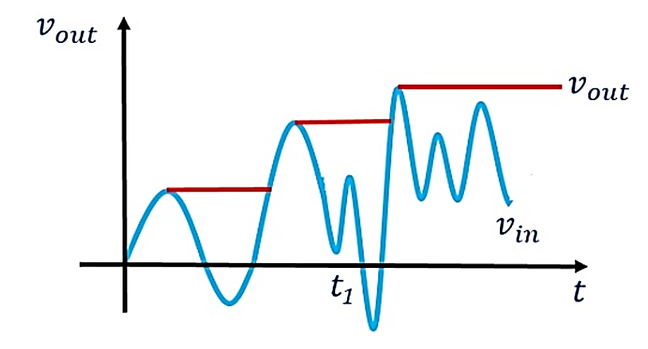

Background
Ideally the output of the peak detector circuit tracks or follows the input voltage until the extreme point is reached but holds that value as the input decreases. The ideal peak detector performs this function regardless speed of the input signal. The performance of the physical peak detector is limited by the bandwidth of the input signal.
LTC6244 High Speed Peak Detector by Gabino Alonso and Hassan Kelley

Slide 5
Background
Ideally the output of the peak detector circuit tracks or follows the input voltage until the extreme point is reached but holds that value as the input decreases. The ideal peak detector performs this function regardless speed of the input signal. The performance of the physical peak detector is limited by the bandwidth of the input signal.
LTC6244 High Speed Peak Detector by Gabino Alonso and Hassan Kelley

Slide 6
Background
Applications
Given a rapidly changing AC input signal,
Peak detectors are used to obtain the peak voltage the signal reaches.
Analysis of spectral and mass spectrometer.
Amplitude modulated wave communication.
Sound measuring instruments.

Slide 7
The abstract idea of following the peaks of some arbitrary input signal might be naively realized in a circuit.
Naive Implementation
Impedance
“Something” to hold the peak values while no new peak was detected
“Something” to follow the peaks
We’re going to need:

Slide 8


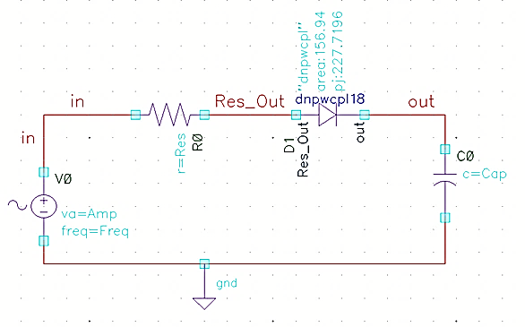

Naive Implementation
Resistor
Diode
Capacitor
problem?

Slide 9
Naive Implementation
YES!
More than one actually…

Slide 10
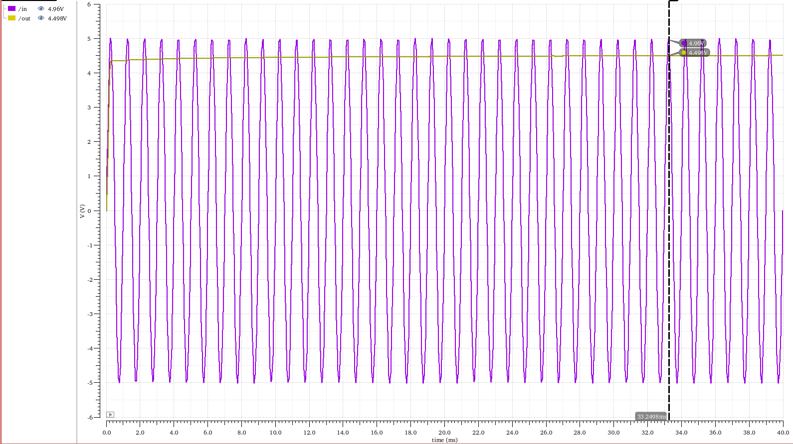
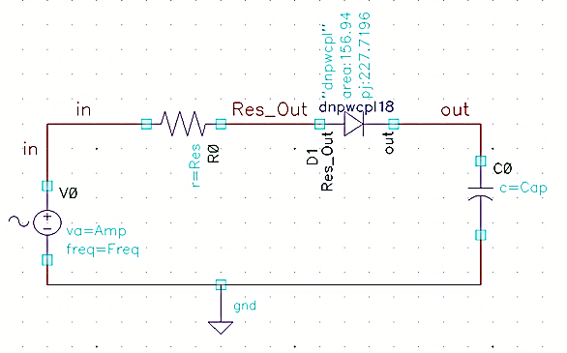

Naive Implementation
The circuit cannot precisely track the input peak voltage because the diode is not an ideal diode.
thus, it has a forward voltage, which its value can be observed as the difference between the input and the output voltage.
Conclusion – Not for small signals detection.

Slide 11
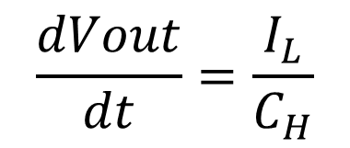
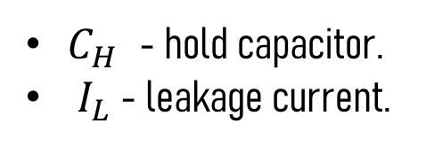
Peak Detector
Major Challenges
is a slow discharge from the hold capacitor through the leakage and the path provided by the following stage. it makes the output peak voltage deviate from the true peak value.
Droop
$$\frac{dVout}{dt}=\frac{I_{L}}{C_{H}}$$
is the rate in which this phenomenon happens
It is proportional to the hold capacitor leakage current.
It depends on the capacitance of the hold capacitor
the droop rate is calculated from the following equation:
Droop rate
$C_{H}$ - hold capacitor.
${ I}_{L}$ - leakage current.

Slide 12
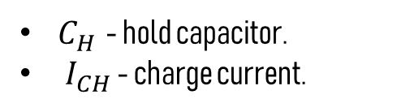
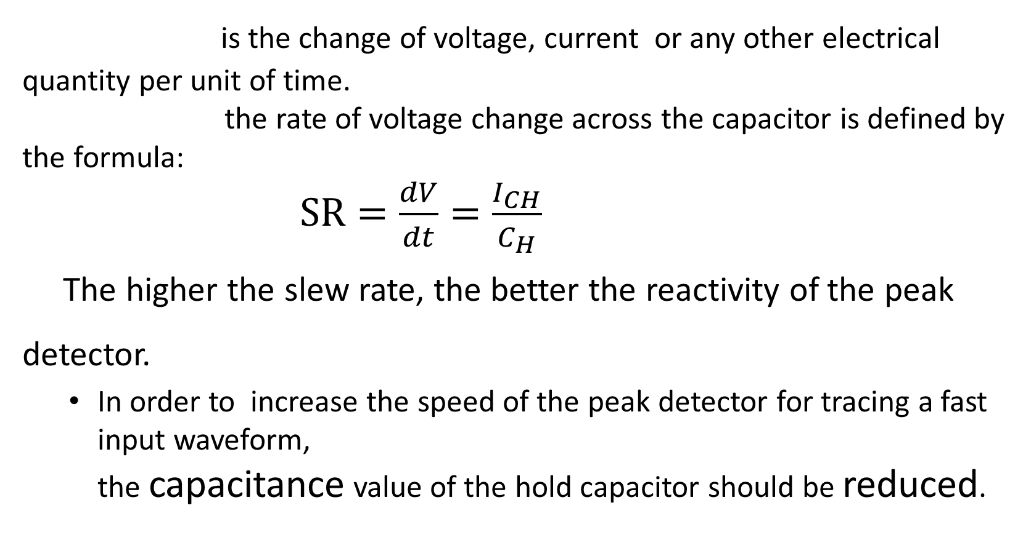
Peak Detector
Major Challenges
is the change of voltage, current or any other electrical quantity per unit of time.
the rate of voltage change across the capacitor is defined by the formula:
$SR=\frac{dV}{dt}=\frac{I_{CH}}{C_{H}}$
The higher the slew rate, the better the reactivity of the peak detector.
In order to increase the speed of the peak detector for tracing a fast input waveform, the capacitance value of the hold capacitor should be reduced.
Slew Rate
$C_{H}$ - hold capacitor.
${ I}_{CH}$ - charge current.

Slide 13

Major Challenges
Tradeoff: droop rate - slew rate
Increasing the slew rate by reducing the capacitance value,
Therefore, there is a trade-off between low droop rate and high slew rate in peak detector design.
As so, constructing a general-signal peak detector might be currently out of reach
will cause a larger droop
because of a faster discharge.

Slide 14
Project definition
And goals
Conduct resaerch in order to understand the operation and properties of the peak detector topology, emphasizing droop and slew rate dependencies.
Design 3 alternative peak detector architectures
Perform an Analysis for each architecture
Compare the analysis results of the different circuits

Slide 15
Project definition
And goals II
Our goals:
Acquire knowledge on analog circuit design
Encounter common challenges of analog circuit design
If possible, reach a consensus about the architecture which performs best
Define relations between circuit parameters (geometry, capacitance, etc..) and their effects on the circuits performance (bandwidth, slew rate, droop)

Slide 16
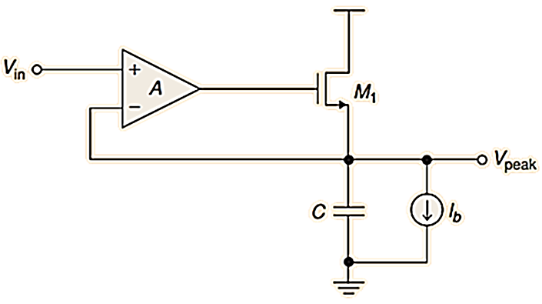
Possible Solutions
1st Solution: Positive peak detector using source follower
 | 1st circuit
Amplifier type | SF Op-Amp
Circuit operation | Capacitor holds the output peak voltage, when V_{in} < V_{peak} and M1 is off
Droop rate control | Droop rate is controlled by capacitance and current source.

Slide 17
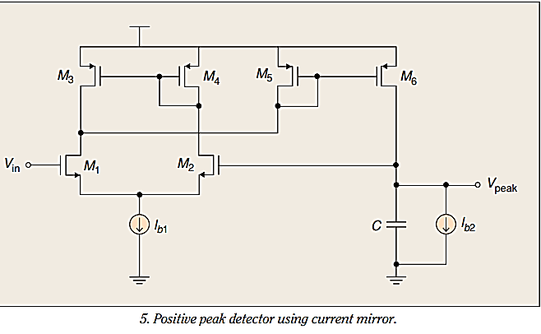
Possible Solutions
2nd Solution: Positive peak detector using current mirror
 | 2nd circuit
Amplifier type | Differential Amplifier (M1-M4) Current mirror (M5-M6) (diode)
Circuit operation | If V_{in} > V_{peak}, the current through M5 and M6 charging the capacitor.
Droop rate control | The droop rate controlled by capacitance values and current source.

Slide 18
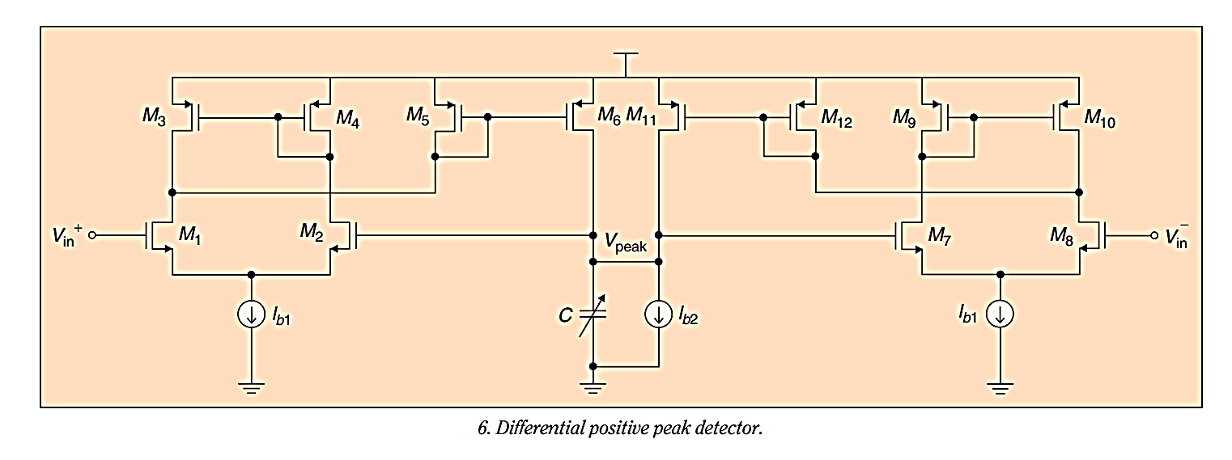
Possible Solutions
3rd Solution: Differential positive peak detector
 | 3rd circuit
Type of amplifier used | Differential version of peak detector using current mirror
Operation of the circuits | Two input signals are fed into the circuit. The single ended output peak voltage is thus the maximum of the two peak voltages.
Droop rate control | controlled by adjusting the values of capacitance and current source.

Slide 19
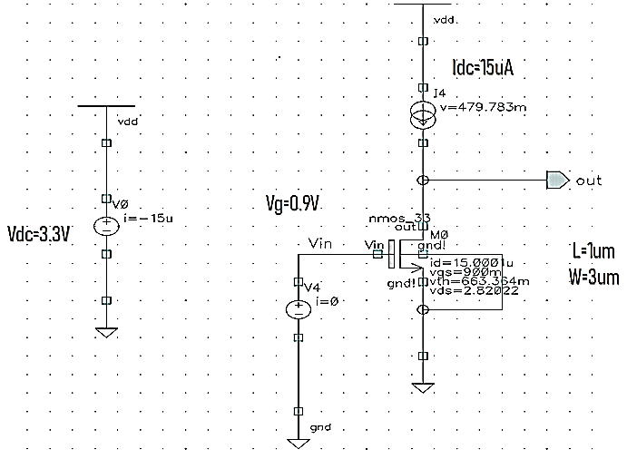
Learning the technology
180nm technology
was selected for this project.
We tested the CMOS behaviors in terms of DC, transient and AC analysis.

Slide 20
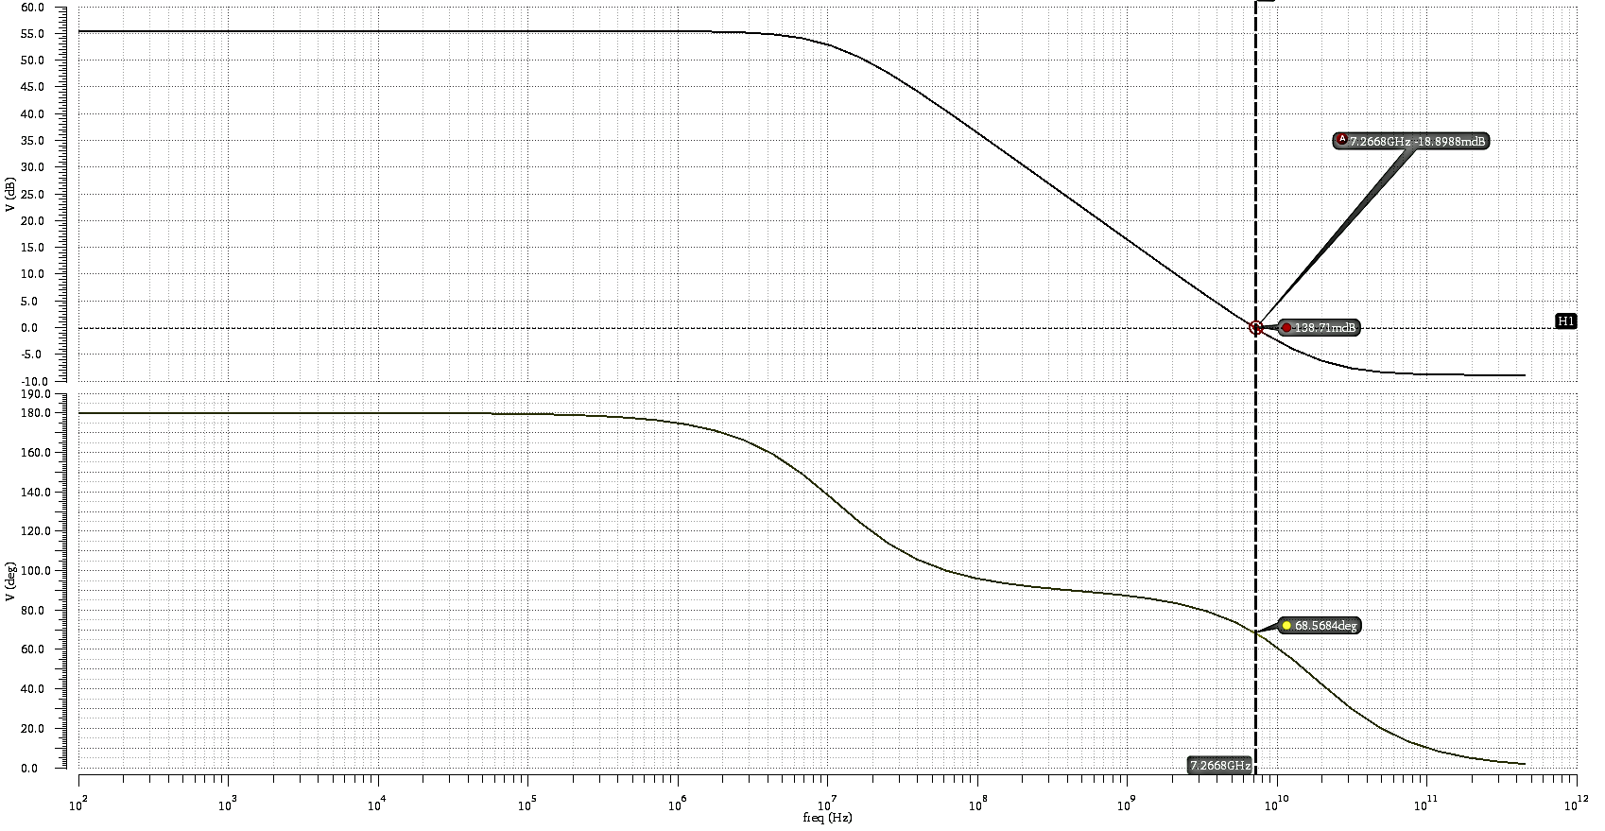
Simulation results: NMOS CS Amplifier
AC analysis
Gain: 55.42db
Bode Gain plot
Gain Bandwidth: 74MHz
Phase Margin: 111.5deg
Bode Phase plot

Slide 21
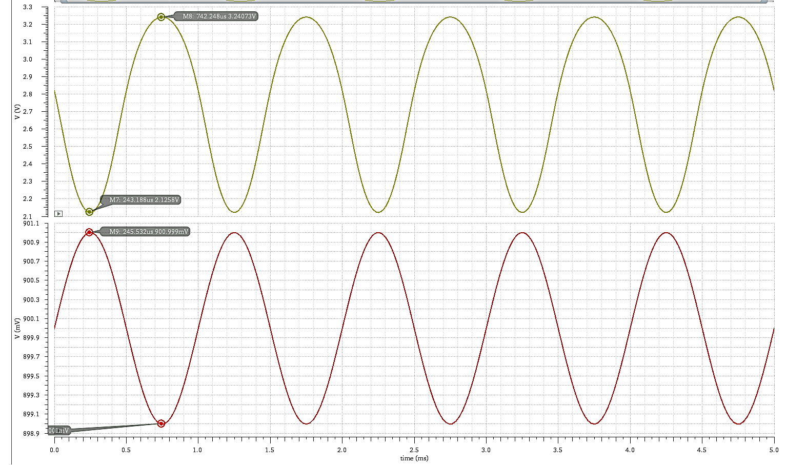
Transient Analysis
Value | Parameter
2mV | Vin,ptp
1kHz | Frequency
Vout
Vout,ptp = 1.12V
Gain = 56
Vin

Slide 22
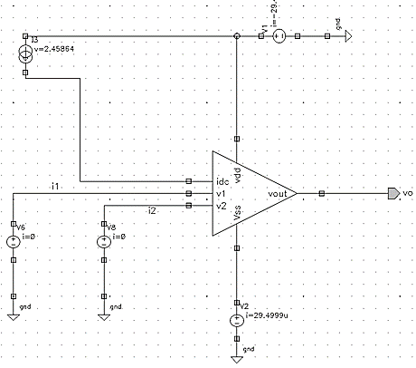
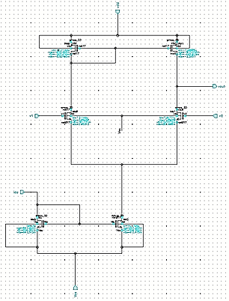
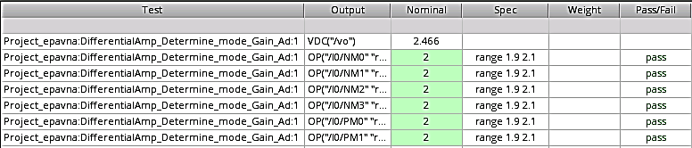
1st circuit Amplifier-Open Loop
DC Analysis and operating point
Value | Param
15uA | Idc
3.3V | Vdc
1.5V | Vin,p
1.5V | Vin,n
1kHz | Freq.
Vout = 2.45 V
I = 30uA
Power = 97uW

Slide 23
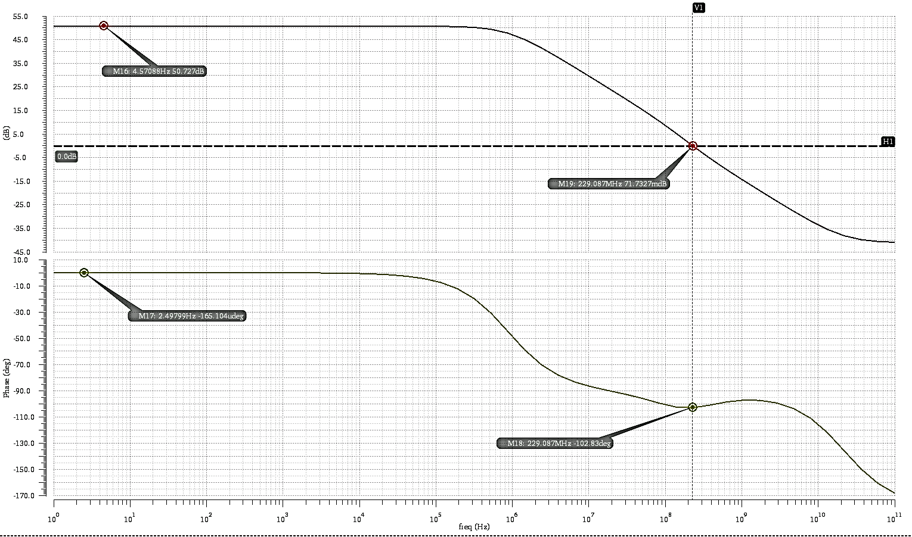
Simulation results Amplifier
AC analysis
Gain: 50.7dB
Bode Gain plot
Gain Bandwidth: 4.9 MHz
Phase Margin: 102.8 deg
Bode Phase plot

Slide 24
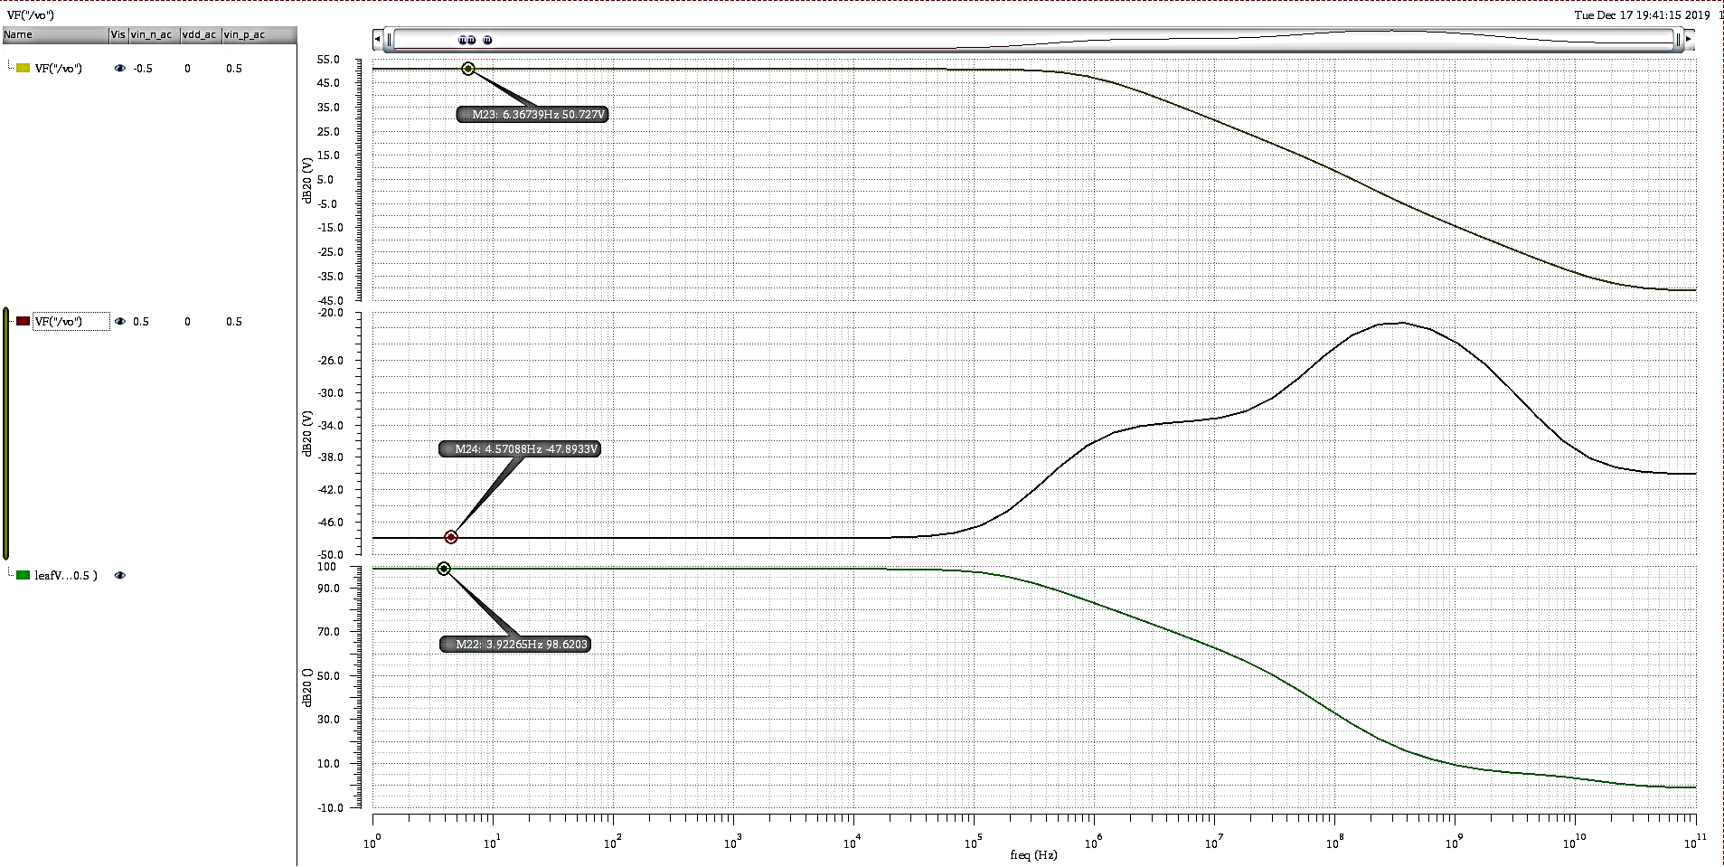
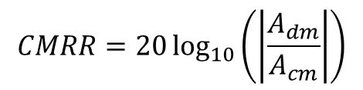
AC analysis- CMRR
$$CMRR=20\log_{10}\left(\left|\frac{A_{dm}}{A_{cm}}\right|\right)$$
Adm
Gain: 50.7dB
Acm
Gain: -49.89dB
CMRR : 98.62dB

Slide 25
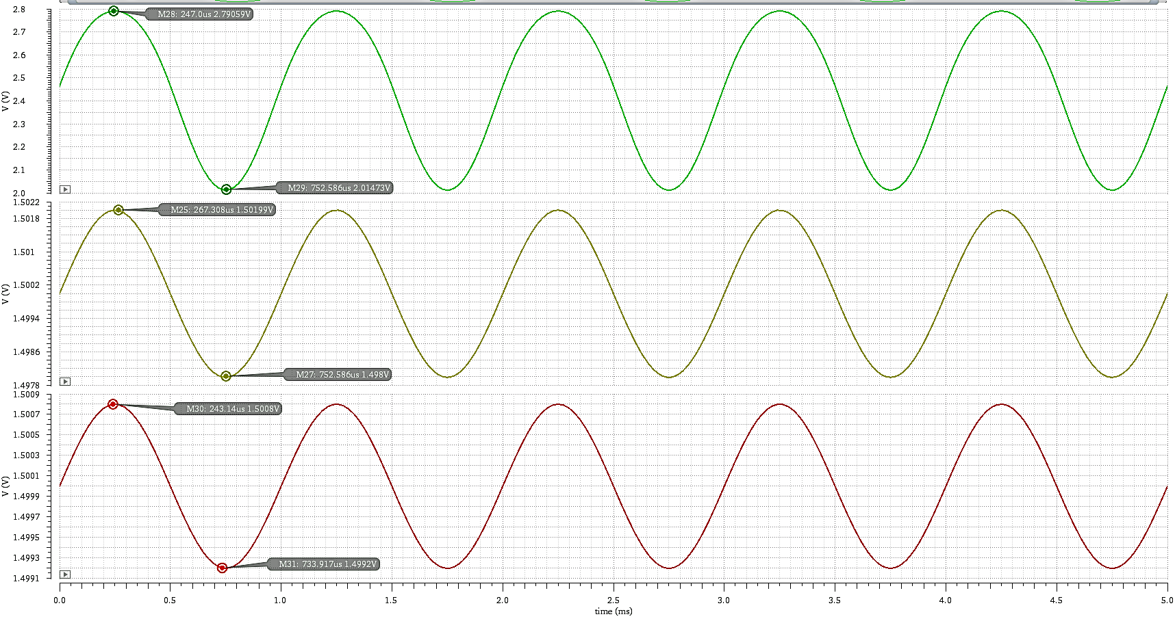
Transient Analysis
Non-inverting differential amplifier (vin,p>vin,n)
Value | Param
4mV | Vin,p,ptp
1.6mV | Vin,n,ptp
1kHz | Freq
Vout
Vin, p
Vout,ptp = 0.77V
Gain = 323
Vin, n

Slide 26
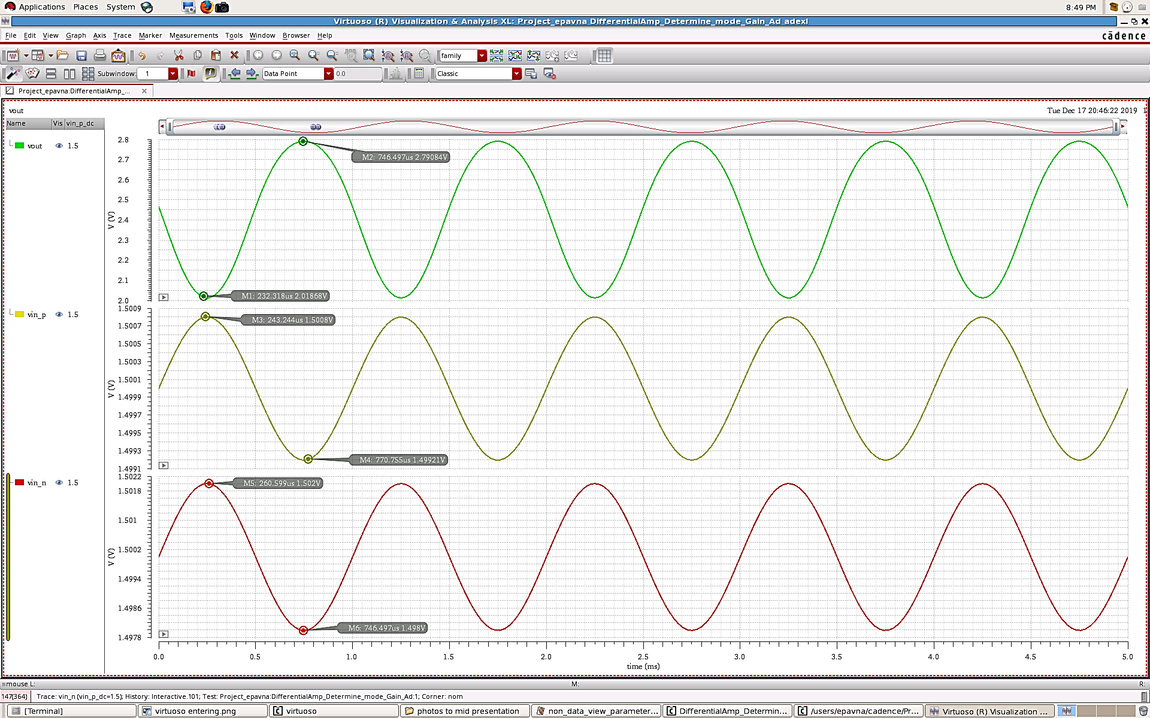
Transient Analysis
inverting differential amplifier (vin,p<vin,n)
Value | Param
1.6mV | Vin,p,ptp
4mV | Vin,n,ptp
1kHz | Freq
Vout
Vin, p
Vout,ptp = 0.77 V
Gain = 322
Vin, n

Slide 27
First Circuit Architecture
Challenges Encounter
1 . While we connected VDD to drain terminal of NMOS transistor that place in the output amplifier, the output voltage(Vpeak) reach to VDD and do not stop on vin,max.
2. When we connect current source/resistor at parallel to Vpeak, and the input fall to zero, The charge from output capacitor start to discharge through the current source.

Slide 28
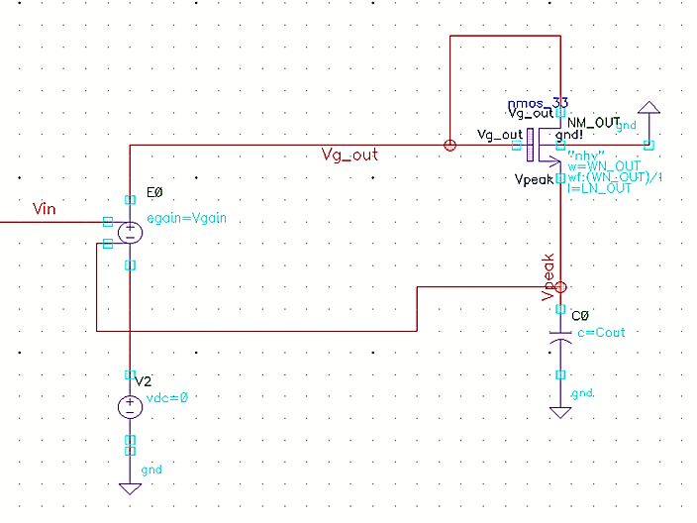
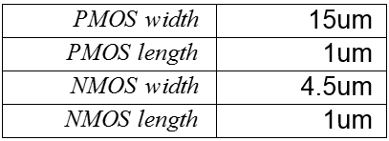
The ideal 1st circuit
Constant parameters
At this circuit We use an ideal amplifier with
-gain= 80dB
-Vout, min=0V
-Vout,max=3.3V

Slide 29
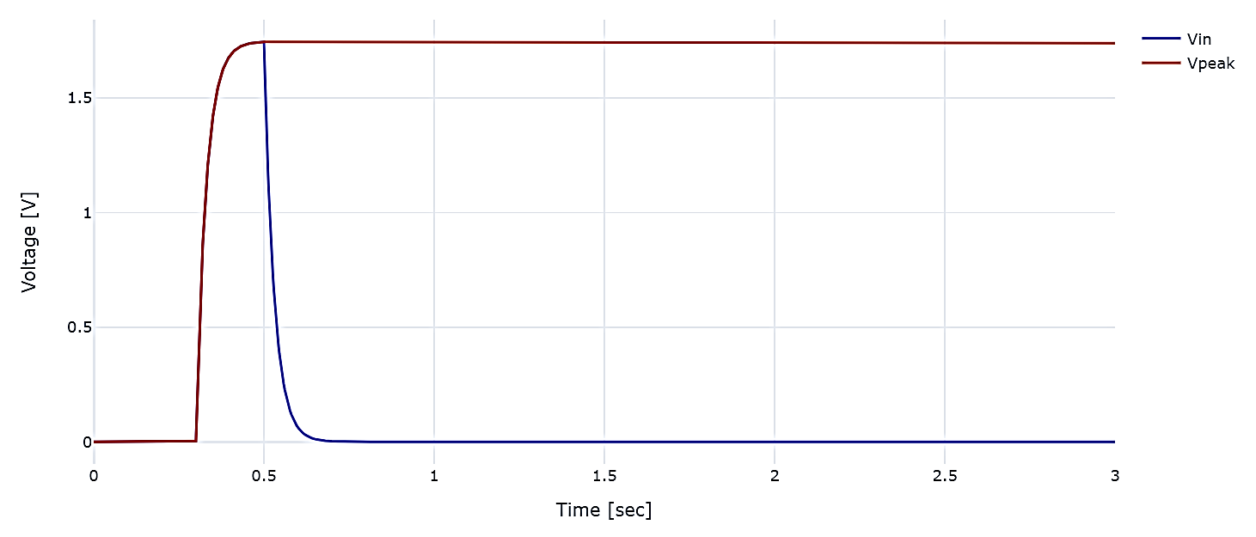
Test 1-General Functionality
- This test checks if the functionality of the circuit behave as expected.
The input is Vexp, rises from 0V to 1.75V.
Cout= 20pF.
- The output follows the input and stay at maximum input even the input voltage fall.

Slide 30
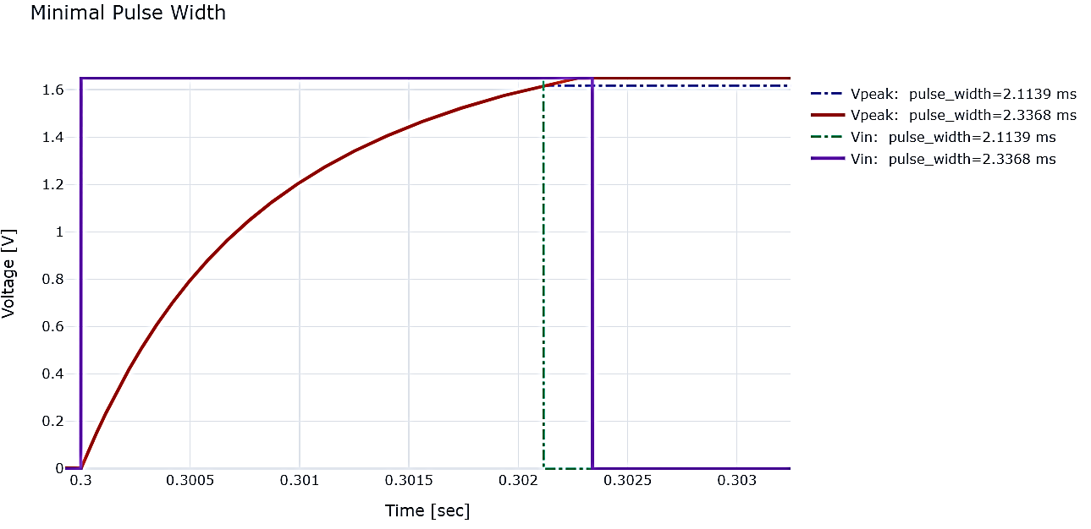
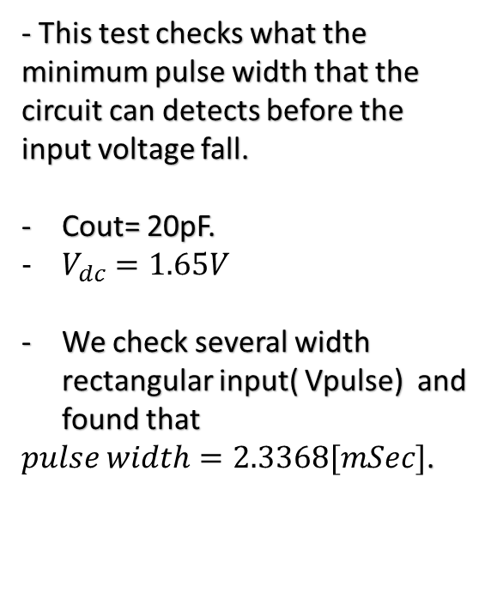
Test 2- Minimum pulse width
That can be detected
- This test checks what the minimum pulse width that the circuit can detects before the input voltage fall.
Cout= 20pF.
$V_{dc}=1.65V$
We check several width rectangular input( Vpulse) and found that
$pulse width=2.3368[mSec]$.

Slide 31
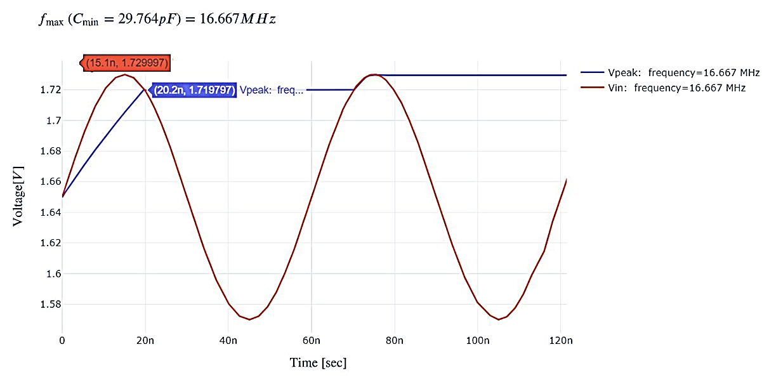
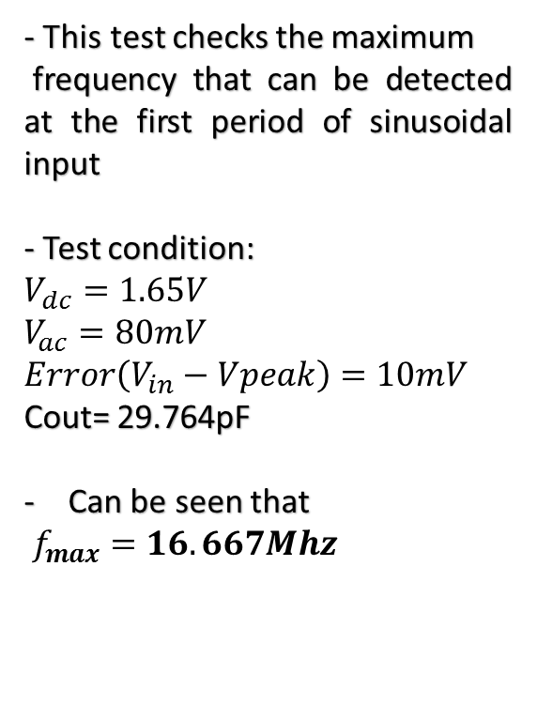
Test 3- Max frequency that
Can be detected at the first period
- This test checks the maximum
frequency that can be detected at the first period of sinusoidal input
- Test condition:
$$V_{dc}=1.65V$$
$$V_{ac}=80mV$$
$$Error\left(V_{in}−Vpeak\right)=10mV$$
Cout= 29.764pF
Can be seen that
$f_{max}=16.667Mhz$

Slide 32
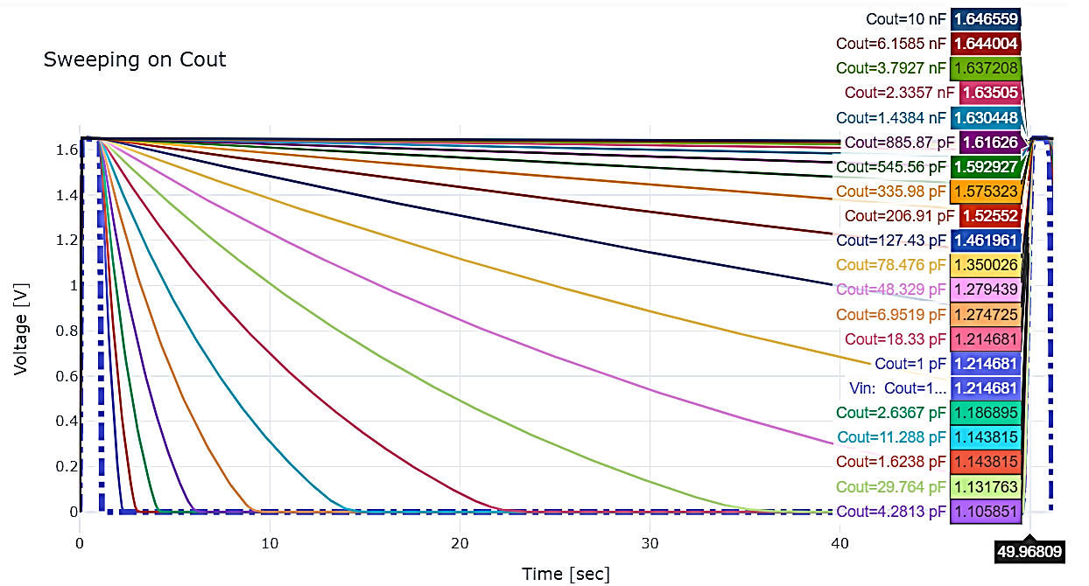
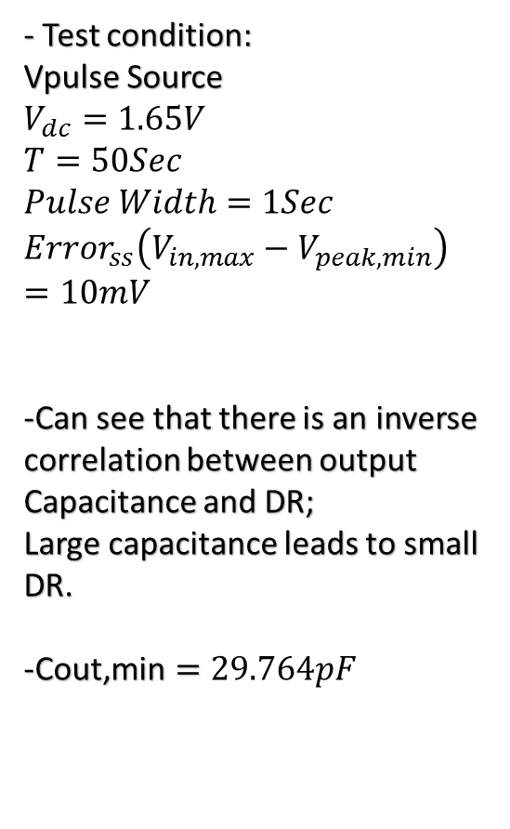
Test 4- Droop Rate depending on
output capacitance
- Test condition:
Vpulse Source
$$V_{dc}=1.65V$$
$$T=50Sec$$
$$Pulse Width=1Sec$$
$$Error_{ss}\left(V_{in,max}−V_{peak,min}\right)=10mV$$
-Can see that there is an inverse
correlation between output
Capacitance and DR;
Large capacitance leads to small DR.
-$\text{Cout}\text{,}\text{min}=29.764pF$

Slide 33
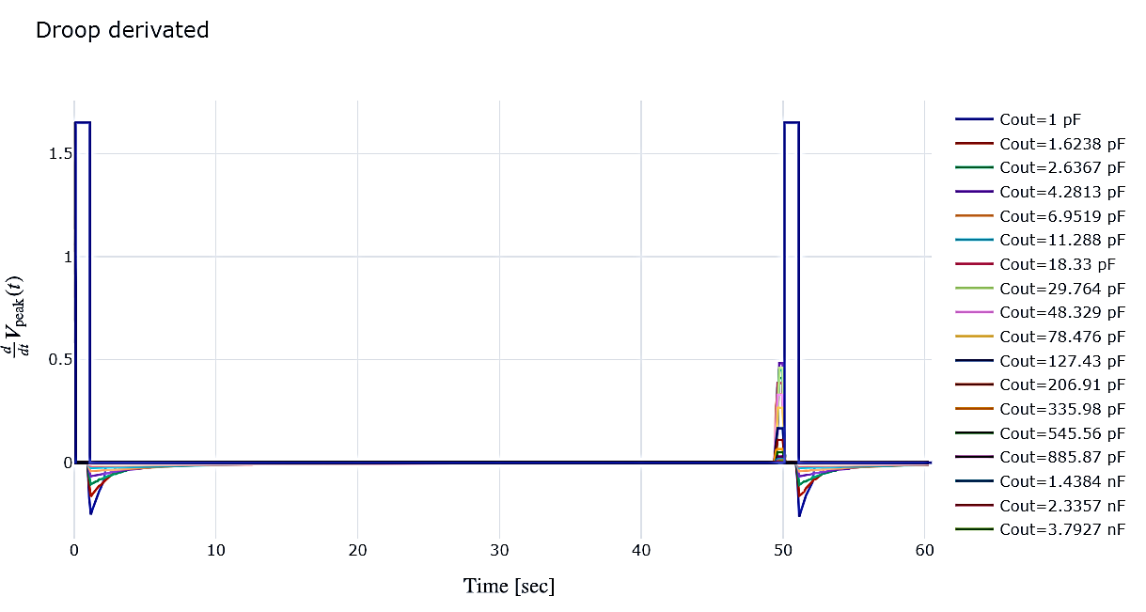
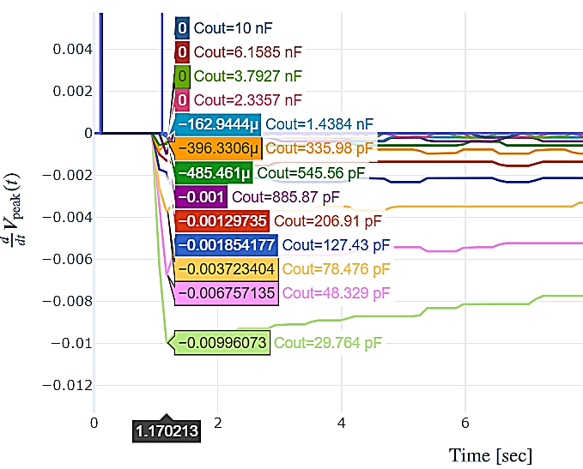
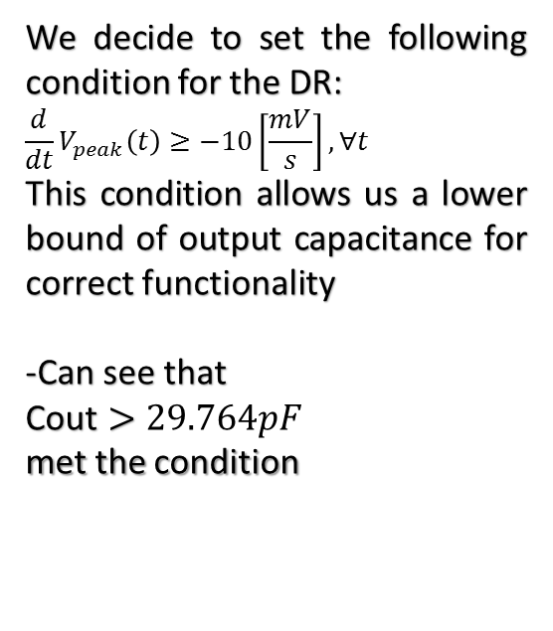
Test 5 – Setting minimum output
capacitance depending on derivative
of the output voltage
We decide to set the following condition for the DR:
$$\frac{d}{dt}V_{peak}\left(t\right)≥−10\left[\frac{mV}{s}\right],∀t$$
This condition allows us a lower bound of output capacitance for correct functionality
-Can see that
$\text{Cout}>29.764pF$
met the condition

Slide 34
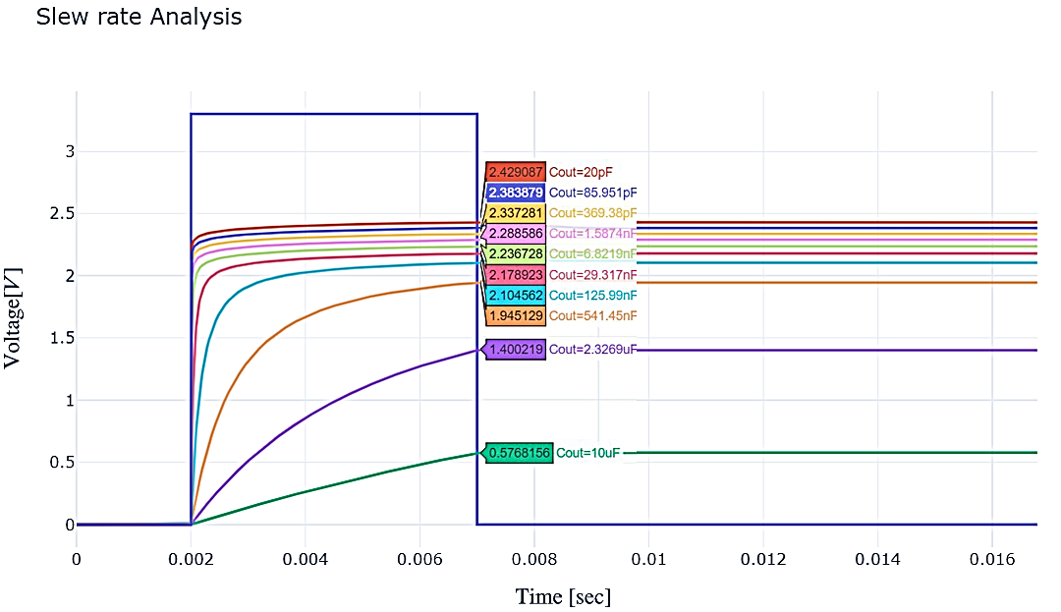

Test 6 – Exposure of Slew Rate
phenomena
- In this test we want to see the SR effect occurs in the circuit
- Test condition:
Vpulse Source
$$V_{dc}=3.3V$$
-Can see that choosing of small capacitance leads to higher SR,
but in Test 5 we get
$\text{Cout}\text{,}\text{min}=29.764pF$.
On the opposite side, large capacitance means smaller DR.
Therefore the minimum pulse width must increase, and need to take it into account

Slide 35
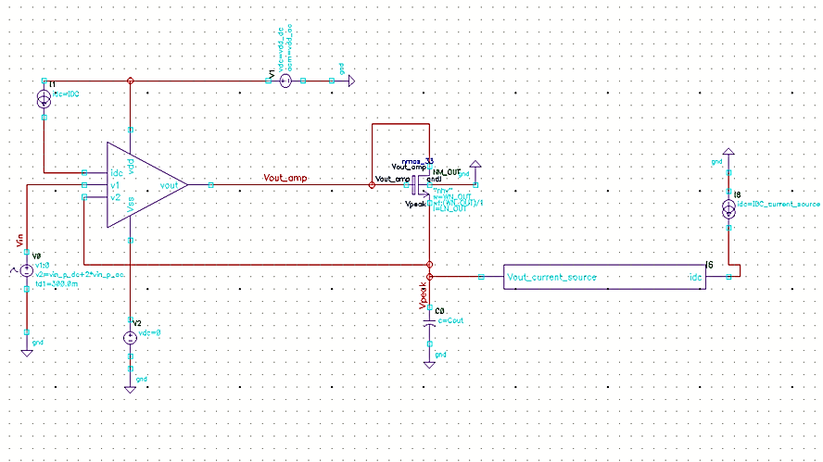
The 1st real circuit
With output current source

Slide 36
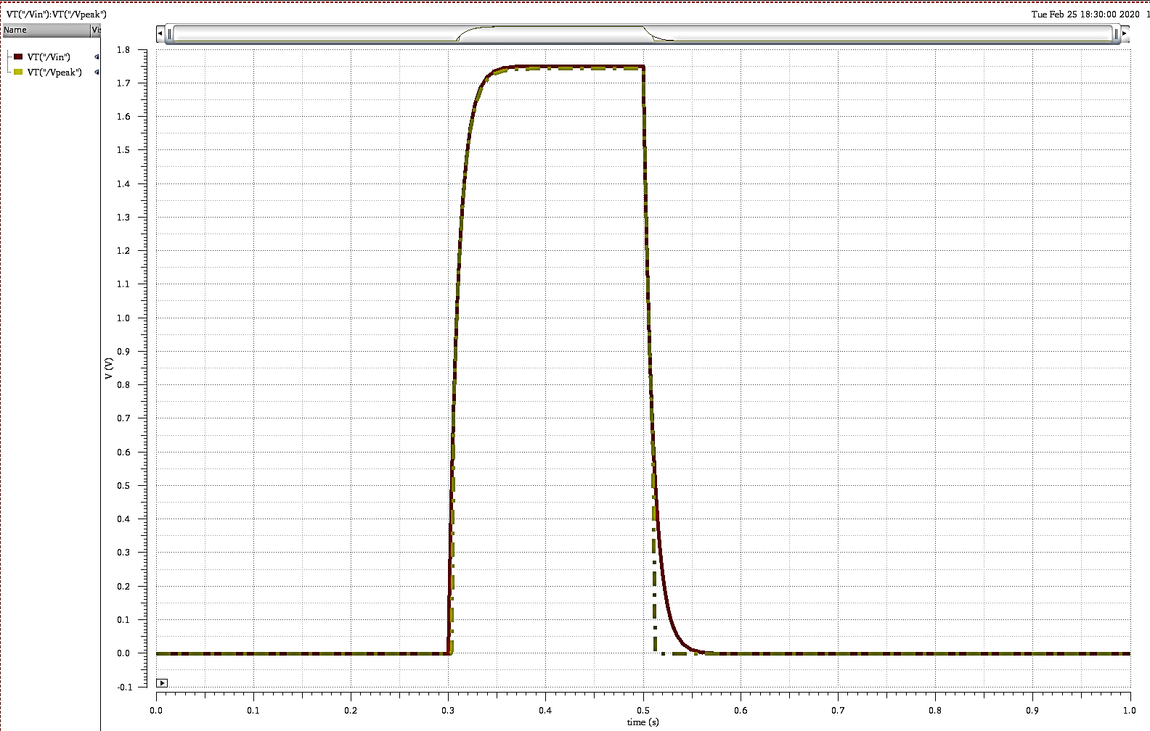
General Functionality
Vpeak
Can be seen that the output follows the input, but it’s starts to fall down immediately after the input fall
The DR is infinite. This is can be good implement for application that DR do not consider
Vin

Slide 37
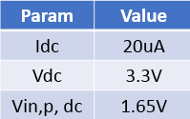
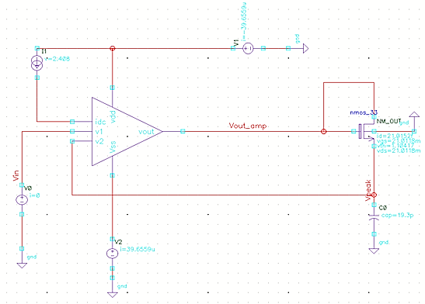

The 1st real circuit
Close Loop- DC Analysis
i=39.65uA
Power Dissipation=130.845uW

Slide 38
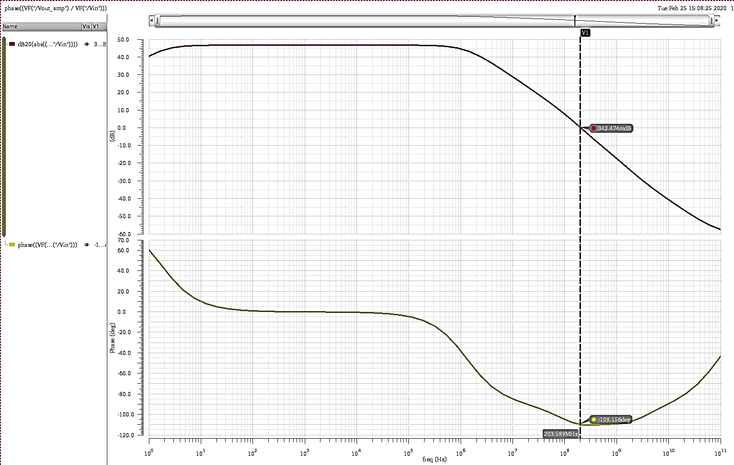
AC Analysis
Bode Gain plot
Gain: 46.68 dB
Gain Bandwidth: 3.634 MHz
GBP: 203.589Mhz
Bode Phase plot
Phase Margin: 70.8 deg

Slide 39
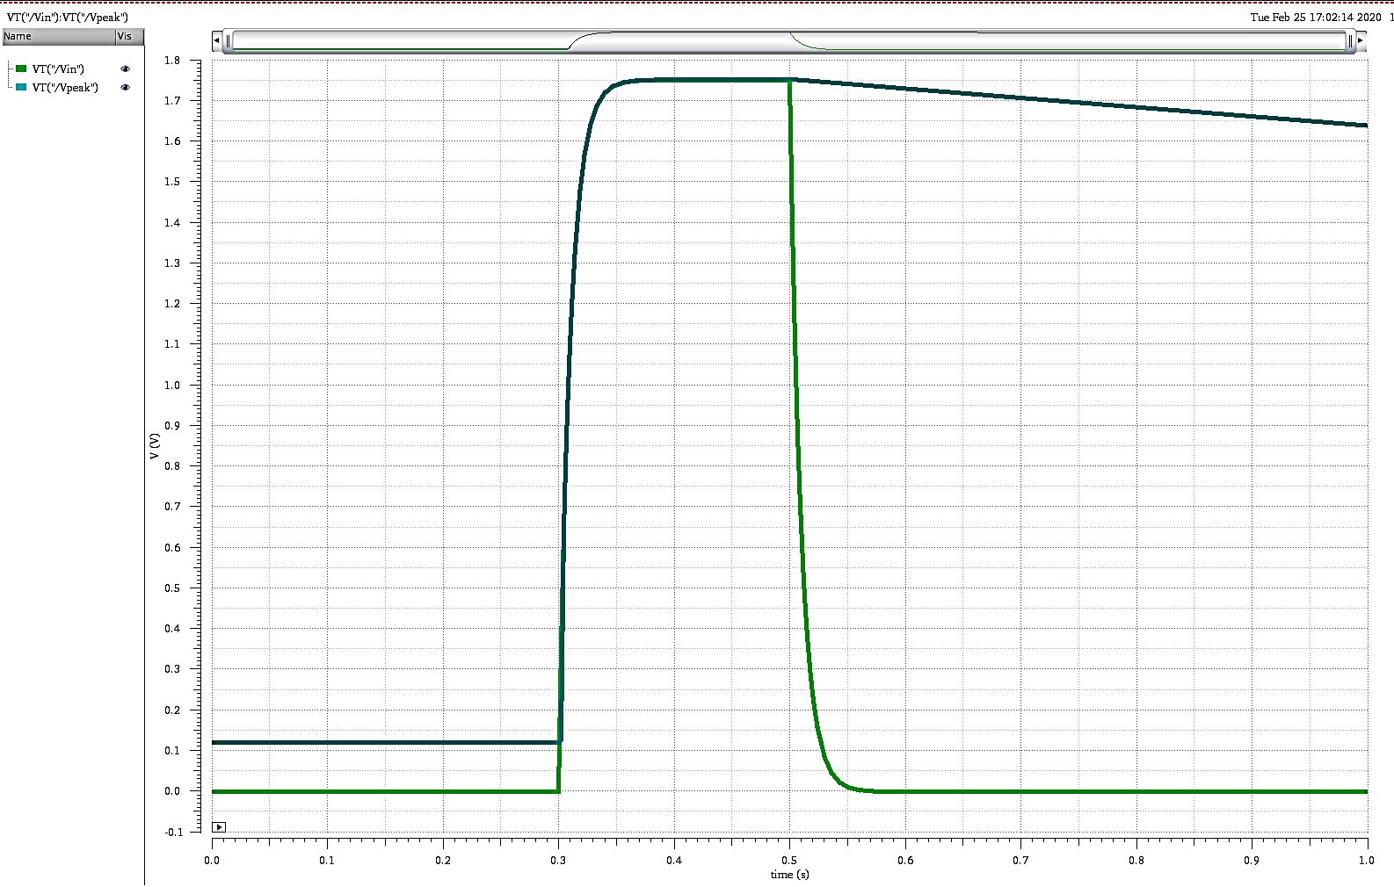
Test 1-General Functionality
- This test checks if the functionality of the circuit behave as expected.
- The input is Vexp, rises from 0V to 1.75V. Cout= 20pF.
- The output follows the input and stay at maximum input even the input voltage fall.
- The DR derives from leakage current.
Vin
Vpeak

Slide 40
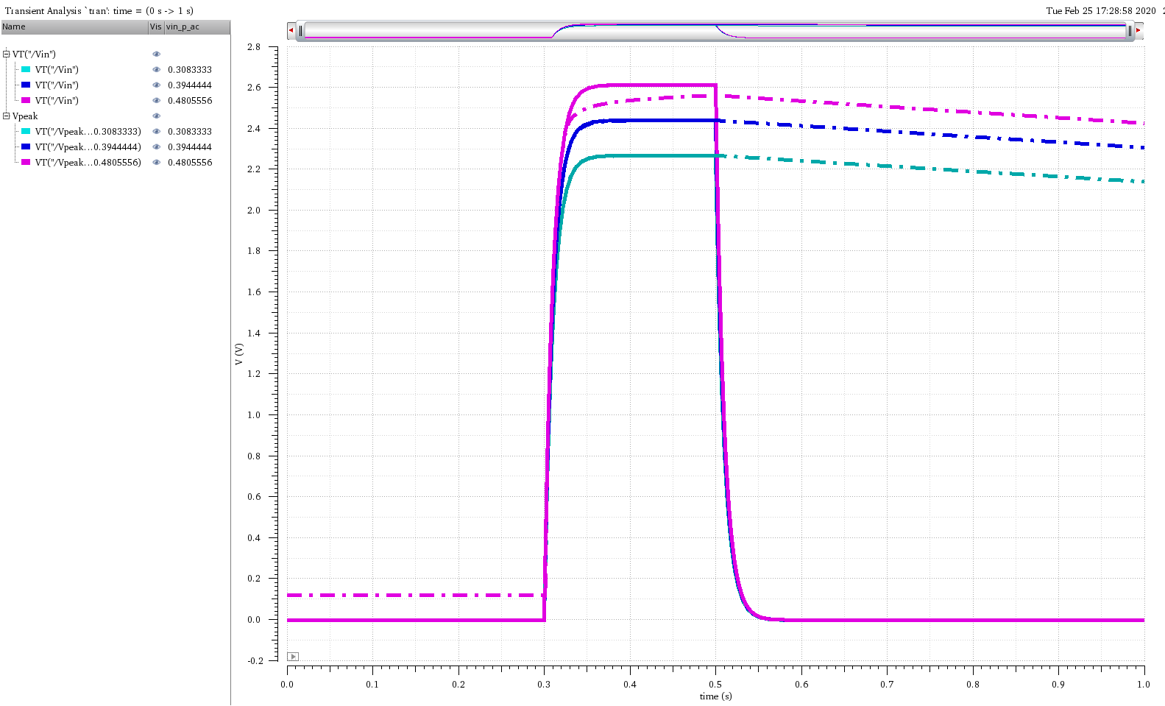
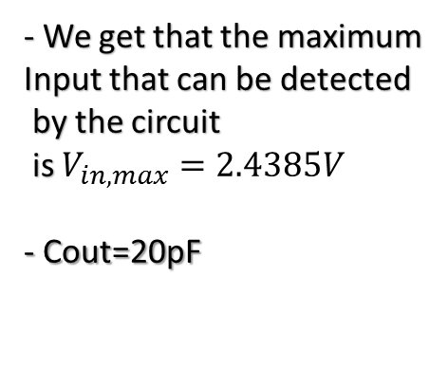
Test 2- Maximum input
Voltage that can be detected
- We get that the maximum
Input that can be detected
by the circuit
is $V_{in,max}=2.4385V$
- Cout=20pF
Vin,3
Vpeak,3
Vin,2
Vpeak,2
Vin,1
Vpeak,1

Slide 41
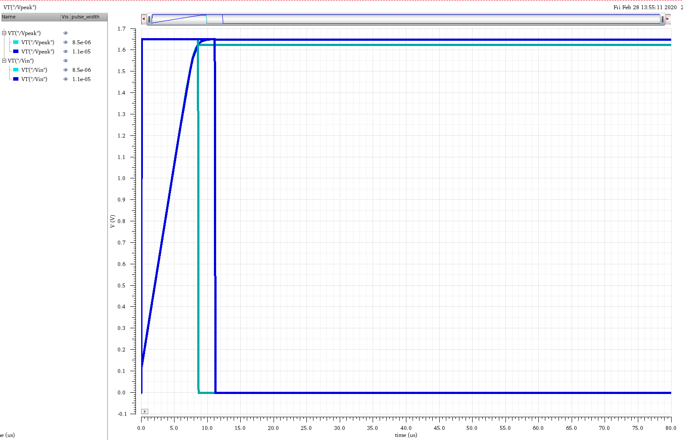
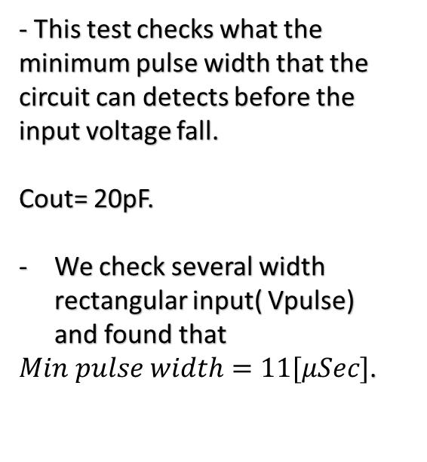
Test 3- Minimum pulse width
That can be detected
- This test checks what the minimum pulse width that the circuit can detects before the input voltage fall.
Cout= 20pF.
We check several width rectangular input( Vpulse) and found that
$Min pulse width=11[μSec]$.
Vpeak,1
Vpeak,2
Vin,2
Vin,1

Slide 42
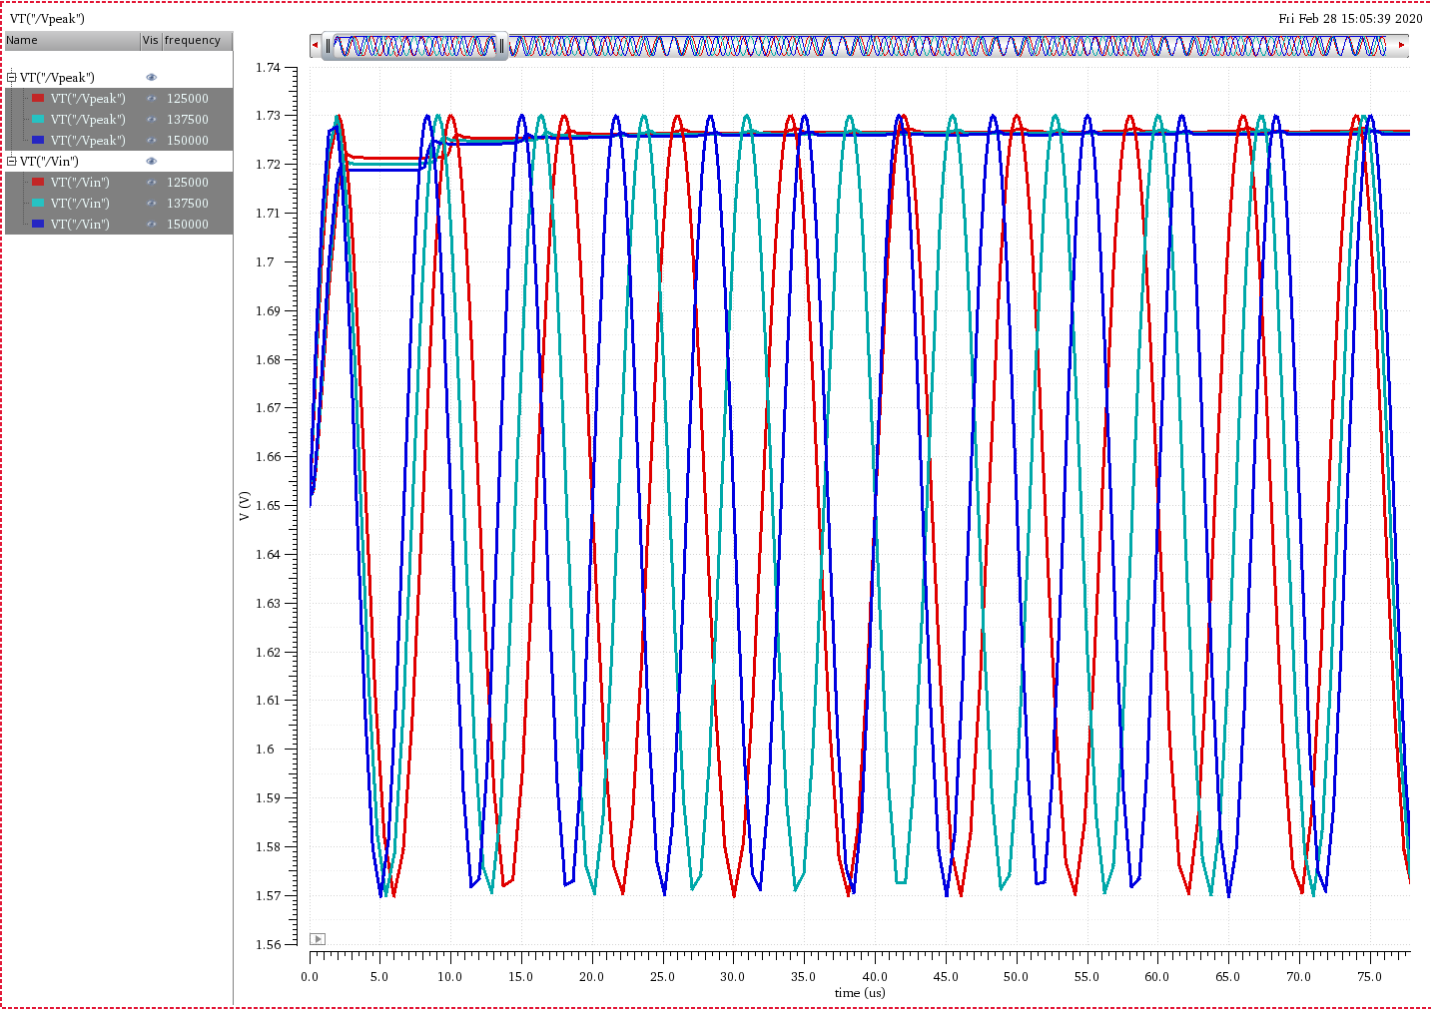
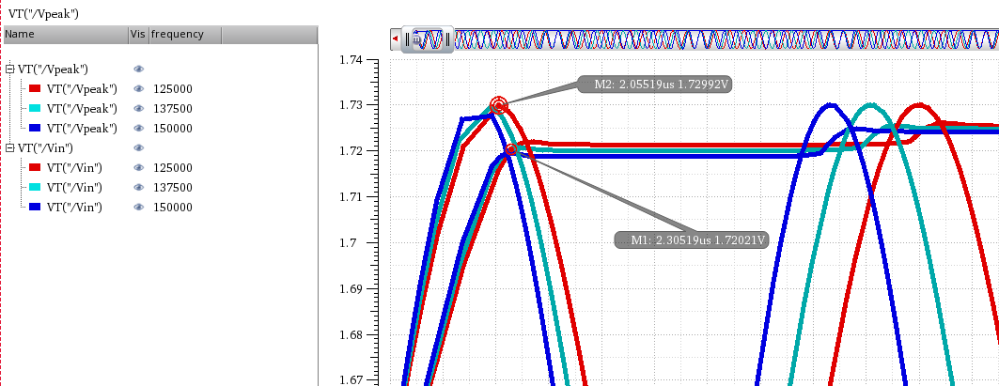
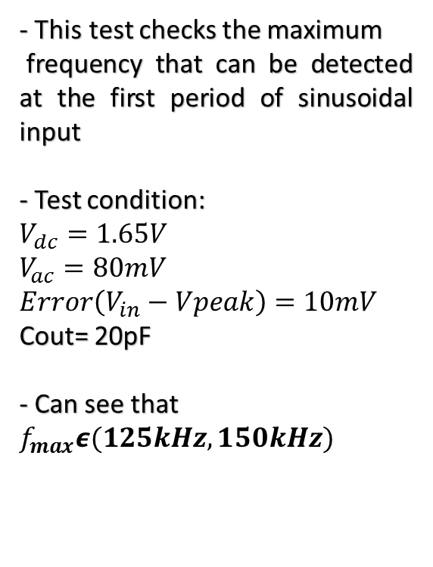
Test 4- Max frequency that
Can be detected at the first period
- This test checks the maximum
frequency that can be detected at the first period of sinusoidal input
- Test condition:
$$V_{dc}=1.65V$$
$$V_{ac}=80mV$$
$$Error\left(V_{in}−Vpeak\right)=10mV$$
Cout= 20pF
- Can see that $f_{max}ε(125kHz, 150kHz)$
Vin,3
Vin,2
Vin,1

Slide 43
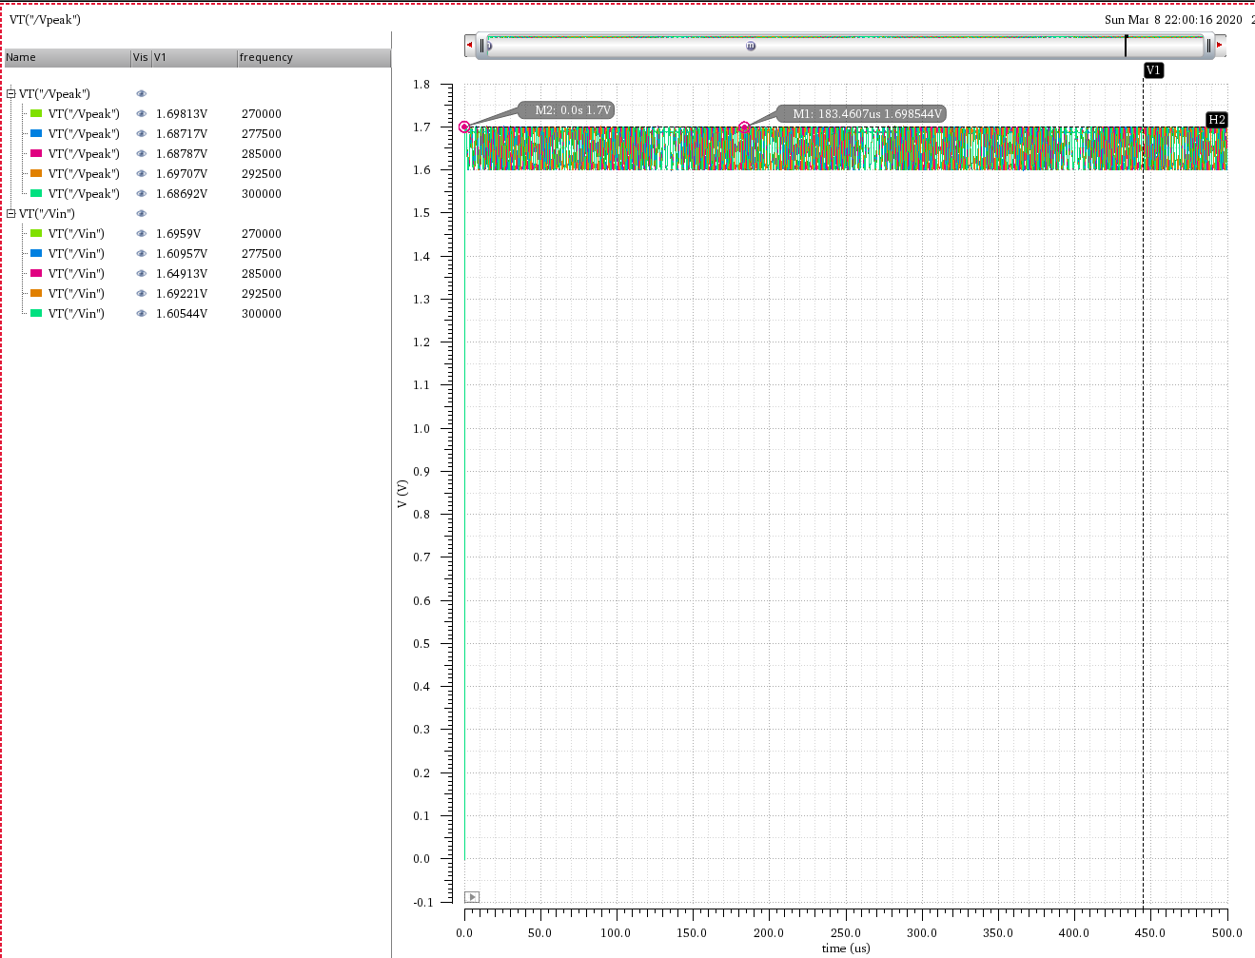
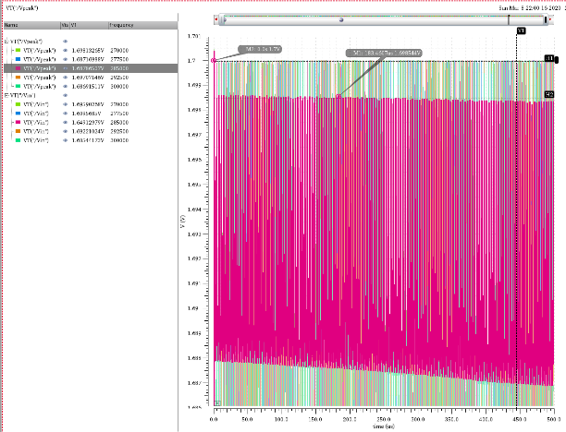

Test 5- Max frequency that
Can be detected at steady state
- This test checks the maximum
frequency that can be detected at at steady state
- Test condition:
$$V_{dc}=1.65V$$
$$V_{ac}=50mV$$
$$Error\left(V_{in}−Vpeak\right)=1.5mV$$
$$C_{out,opt}=1pF$$
$V_{ac}$ above condition chosen because at 80mV the circuit can't follow- stays at 1.65V at tenth KHz
- Can see that $f_{max, s.s }ε(270kHz, 300kHz)$
- peak founds at the first period so we decide to do one more test to detect the max frequency

Slide 44



Test 6- Max frequency that
Can be detected at the first period
at high frequency
- This test checks the maximum
frequency that can be detected at at first period at high frequency
- Test condition:
$$V_{dc}=1.65V$$
$$V_{ac}=50mV$$
$$Error\left(V_{in}−Vpeak\right)=1.5mV$$
$$C_{out,opt}=1pF$$
Can see that
$$f_{max}=1.6625MHz$$
Vpeak

Slide 45


Test 7- Max sinusoidal input with
Damping factor that can be detected
- This test checks the maximum
voltage that can be detected for sinusoidal input with damping factor
- Test condition:
$$V_{dc}=1.65V$$
$$V_{ac, t=0[sec]}=50mV$$
$$f=10KHz$$
$$C_{out}=20pF$$
$$Damping Factor=−0.5$$
Can see that for this test
The output follows up to
$V_{peak,max}=2.396V$ and after stop the following
Vpeak
Vin

Slide 46




Test 8- founding range capacitance
For Pulse Width=2*min, Pulse Width
- This test contains several constrain parameter that gives evaluation of choosing output capacitance for pulse width=2*minimum pulse width(Test 3)
Vin
Vpeak
Test condition:
Vpulse: ${ V}_{dc}=1.65V$ , $T=100μSec$
$$Pulse Width t=20μSec$$
$$Error\left(V_{in}−Vpeak\right)=10mV$$
$$Vpeak=Vin,max=1.65V$$
$@min,pulse width$=$10μSec$
SR
$C_{out}ε(2.6pF, 19.3pF)$
$$Slew Rate_{min}=189.3578\frac{kV}{Sec}≈0.19\frac{V}{μSec}$$

Slide 47


Test 9- founding range capacitance
depending on Droop Rate
- This test is Figure Of Merit of range capacitance depending on DR
Test condition:
Vpulse Source
$$V_{dc}=1.65V$$
$$T=5Sec$$
$$Pulse Width=1mSec$$
$$Error_{ss}\left(V_{in,max}−V_{peak,min}\right)=10mV$$
$$DR,max=20\frac{mV}{Sec}$$
-Can see that
$$C_{out}ε(200pF, 2nF)$$
Vin
Vpeak
DR

Slide 48
2nd Circuit Architecture
Challenges Encounter
Similar to the 1st circuit when we connected VDD to source terminal of PMOS transistor, the output voltage(Vpeak) reached to VDD and do not stop on vin,max.
we try to solve it by connecting current source parallel to output capacitor. This do not solve the entire problem; we got peak of VDD at the start of the operation.
Eventually the source of the PMOS was connected to source of NMOS diode connection such that the NMOS behave like current source.
In addition, we connect the PMOS as diode connection to prevent infinite DR while the input voltage fall bellow the output volatge.

Slide 49


2nd Circuit Architecture
Challenges Encounter- example
- We try several output current that can control on the Discharge capacitor
Vpeak
Vin
We get always a peak of VDD
at the first of the operation

Slide 50


The ideal 2nd circuit
Constant parameters
At this circuit we use an ideal amplifier with
-gain= 80dB
-Vout, min=0V
-Vout,max=3.3V

Slide 51

Comparison between 1st
and 2nd ideal circuit
-We did the same tests in
the 2nd circuit and summarized
The result at Table comparison
- The performances of the 1st circuit
are better in more tests but both of
them behave as peak detector
- The use of the 1st or 2nd circuit can be considered
dependent on specific application
for example- for high input voltage detection 1st circuit
Is better, but for minimum pulse width 2nd circuit preferred

Slide 52




2nd circuit Amplifier
$MOSFET cascode differetial amp with cascode active load$
We choose that amplifier because the large gain in open loop.
PM8
$R_{0,6}=r_{0, 6}(1+g_{m,8}r_{0, 8}$)≅ $r_{0, 6}$ $g_{m,8}r_{0, 8}$
PM6
NM4
$R_{0,4}=r_{0, 4}(1+g_{m,2}r_{0, 2}$)≅ $r_{0, 4}$ $g_{m,2}r_{0, 2}$
Also, this is great opportunity to acquire experience in complex amplifier design
NM2
Gain:
$A_{d}=g_{m,4}(r_{0, 4}$ $g_{m,2}r_{0, 2}||r_{0, 6} g_{m,8}r_{0, 8}$)

Slide 53



Simulation results Amplifier-Open Loop
DC Analysis and operating point
I,max=30mA
Power Dissipation=99mW

Slide 54

AC analysis
Gain: 83.363dB
Gain Bandwidth: 81.02 KHz
GBP: 72.42Mhz
Bode Gain plot
Bode Phase plot
Phase Margin: 70.885 deg

Slide 55

AC analysis- CMRR
$$CMRR=20\log_{10}\left(\left|\frac{A_{dm}}{A_{cm}}\right|\right)$$
Adm
Gain: 83.363dB
Acm
Gain: -48.4189dB
CMRR : 131.782dB

Slide 56


Transient Analysis
Non-inverting differential amplifier (vin,p>vin,n)
Vin, p
Vin, n
Vout,ptp=0.1725V
Gain=14375
Vout

Slide 57


Transient Analysis
inverting differential amplifier (vin,p<vin,n)
Vin, p
Vin, n
Vout,ptp=0.17292V
Gain=14410
Vout

Slide 58



The 2nd real circuit
Close Loop- DC Analysis
I=30mA
Power Dissipation=99.05mW

Slide 59

AC Analysis
Bode Gain plot
DC Gain: 88.0436 mdB
Gain@high frequency:
46.4437 dB
Bode Phase plot
Phase Margin: 170.2 deg

Slide 60


Comparison between 1st
and 2nd real circuit
The performance of the 1st circuit is better in more tests, but both of them behave as peak detector.
The usage depends on application. for ex. :
detection of higher frequency at first peak - 1st (Test 4),
detection higher frequency at Steady State- 2nd

Slide 61

3rd architecture with
real amplifier

Slide 62



Test- Tracing of 2 sinusoidal
Input with different amplitude
- Test Purpose- given 2 sinusoidal input $V_{in,right},V_{in,left}$ , we’d like to check the tracing operation:
our assumption is that the output will follow the larger amplitude out of 2 inputs.
-Test condition:
$$V_{in,right,DC}=V_{in,left,DC}=1.65V \\ V_{in,right,AC}=50mV,θ_{t=0}=−\frac{π}{2} \\ frequencies=1kHz \\ V_{in,left,AC}=20mV \\ Dampingfactor_{right}=−0.5 \\ Dampingfactor_{left}=−1.5 \\ C_{out}=1μF$$
the result is as we expected, see that the output
voltage stop tracing of right input and starts tracing
after left input

Slide 63

Tracing of 2 sinusoidal
Input with different amplitude-
continue
-Can see that the transition of tracing
from the right input to the left input
occurs at 1.809Sec

Slide 64

Summary- What do we learn
Designing amplifiers in open/close loop- amp equation,
stability at operating point, DC, ac and transient analysis, implementation equation transistors and optimization of geometrical size transistors inside the circuit
Problems solving- building abilities to deal with challenges during designing circuit , by means of thinking and analyzing goal-oriented
Independent work- we try to work independent during the project, but it was important for us to get instruction from Alex, our guidance, when we were need him. This process helps us to develop accountability and initiative. Also, during the project we added more test in order to produce theoretical and practical experiences

Slide 65
What do we learn- continue
Software learning- we learn Virtuoso and part of the tools it provide for circuits design
Prior planning- early preparation of goals project in theoretical part minimize the problem during the design.
previous experience helps
Complexity of circuits designing- Complex circuits; more transistors and tight restriction, require higher skill
Interesting Domain- designing of analog circuits in general and peak detectors in particular, putting challenges and restrictions that solving them gives great satisfaction. Also, the circuits have great importance in engineering application such as medical equipment, sound, computer, etc.
Thank you

